Slide 1
A Project on Job Searching Web Application Muhammad Abdul Wadud Azad ID:1245212 Round 37

Slide 2
Quick Job Inc.
Requirements:
We need to build software for Quick Job Corporation. The application will have following features:
There will be five types of user like Admin, Employees, Job-seeker, Operator and Company.
There will be employees like manager, account manager, advertising manager and financial manager.
There will be login for Admin, Employees, Job-seeker, Operator and Company.
Admin can see and edit every table like Job Post list, Job Category list, Role list, Company list also Job-seeker list. Admin can edit data and get information of all about.
Operator will get short time login authentication until their job finish.
Employees can operate page as their specialty.
Company can upload a job post and how many Job-seeker applied in their company, who applied and they can also see the CV of Job-seeker.
Job-seeker can see who many jobs are available, what types of jobs are available, upload and create their CV and will be able to apply in jobs as their skill

Slide 3
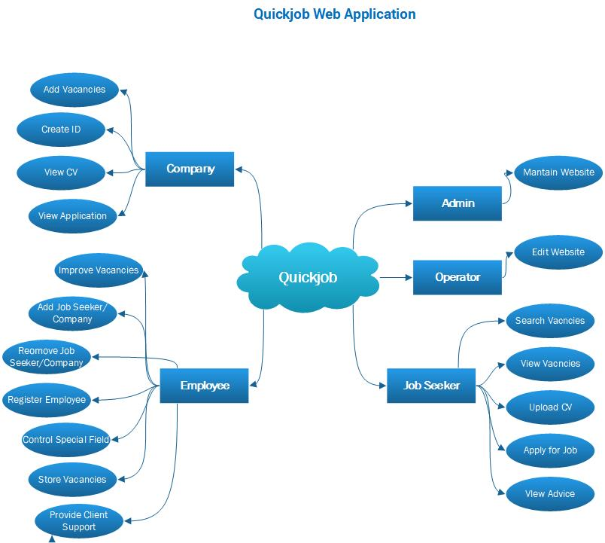
Brainstorming Diagram

Slide 4
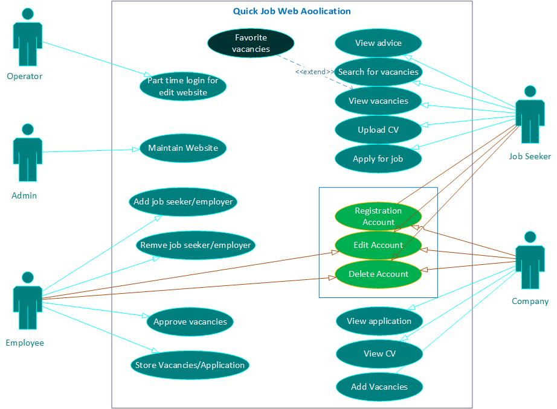
Use Case Diagram

Slide 5
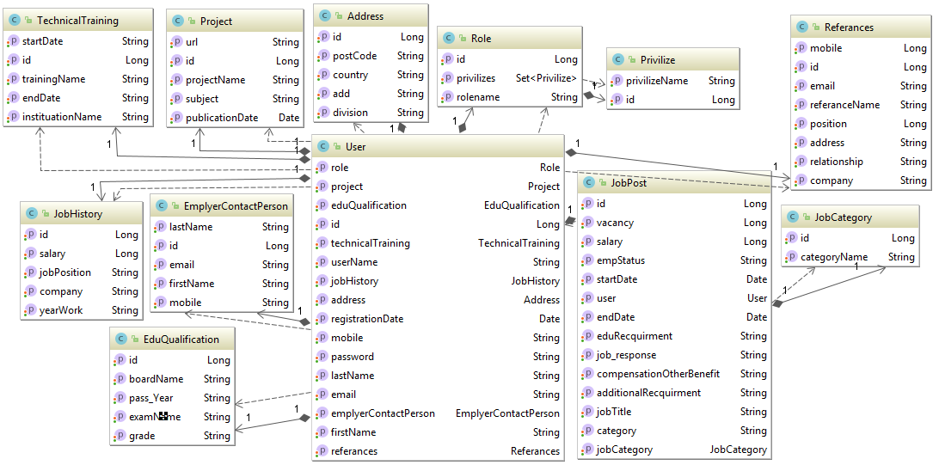
Class Diagram

Slide 6
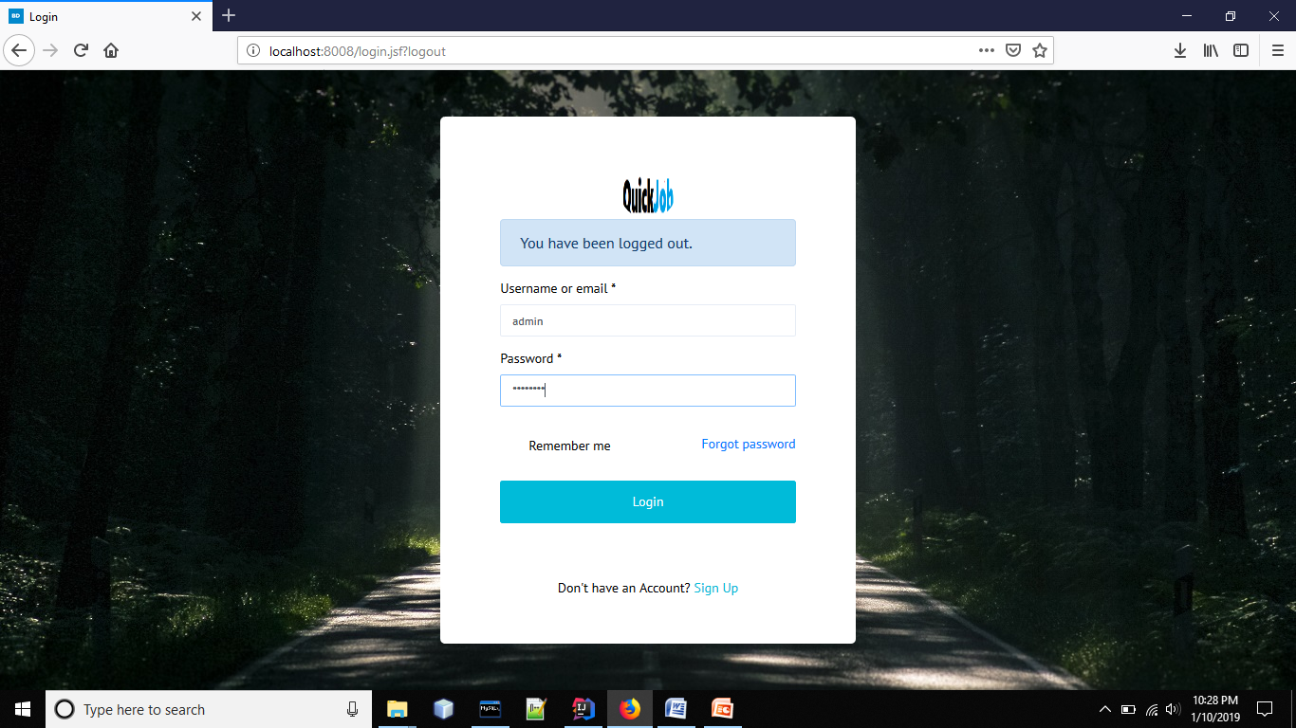

Slide 7
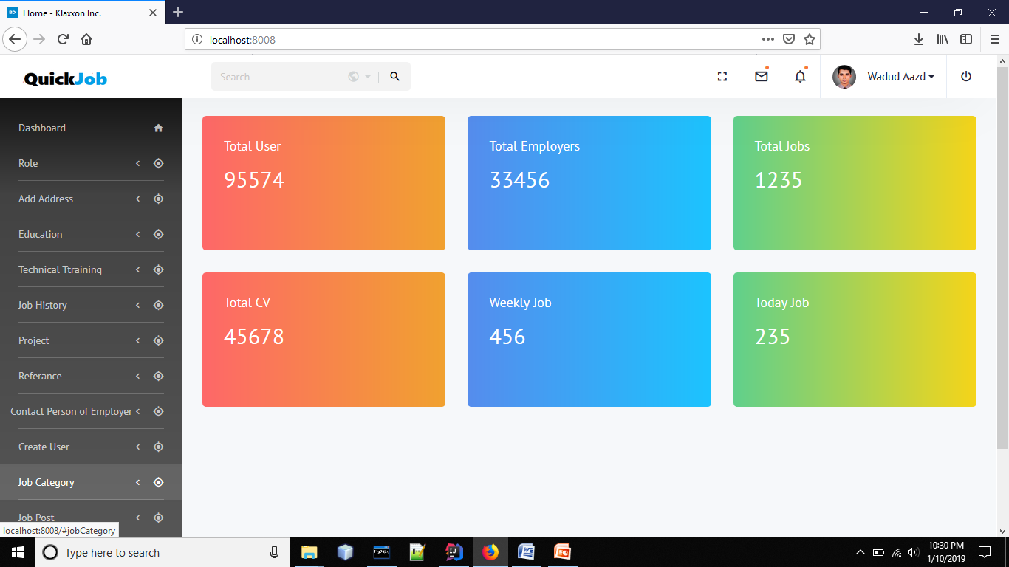

Slide 8
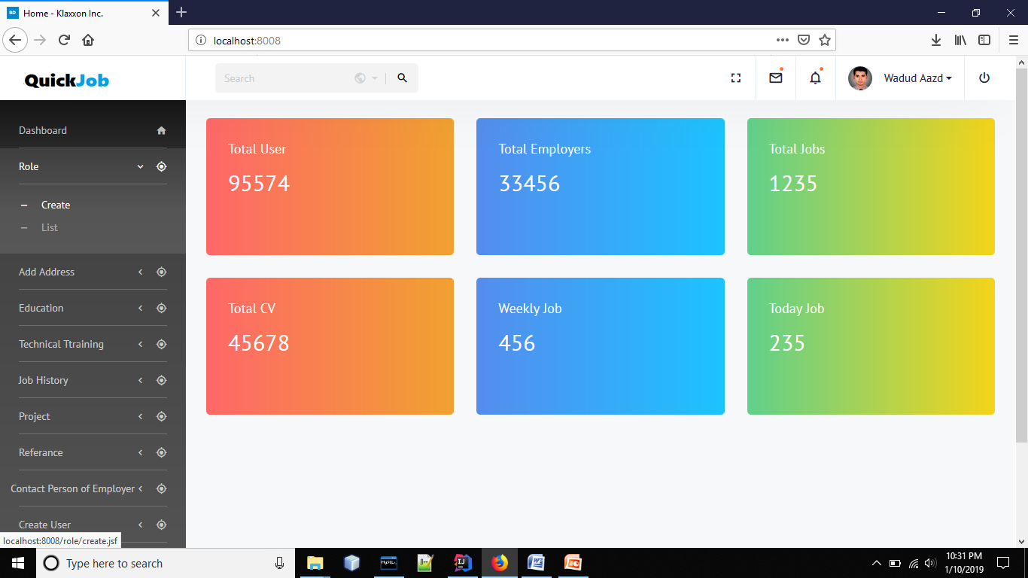

Slide 9
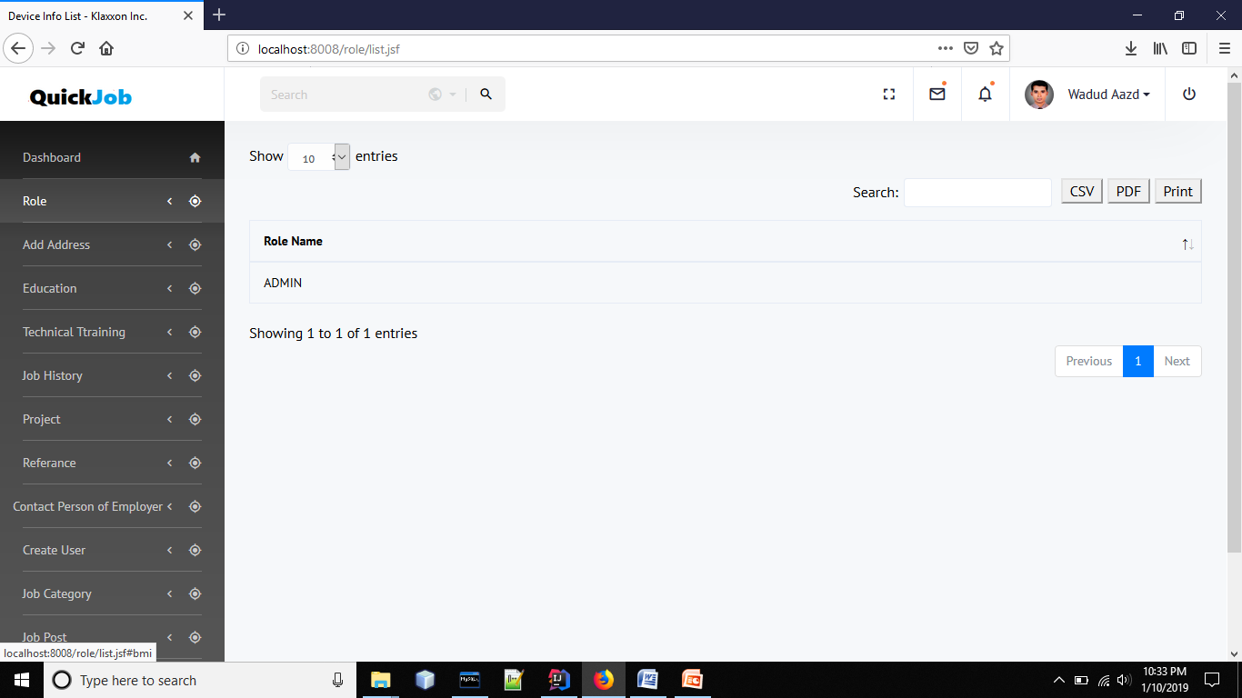

Slide 10
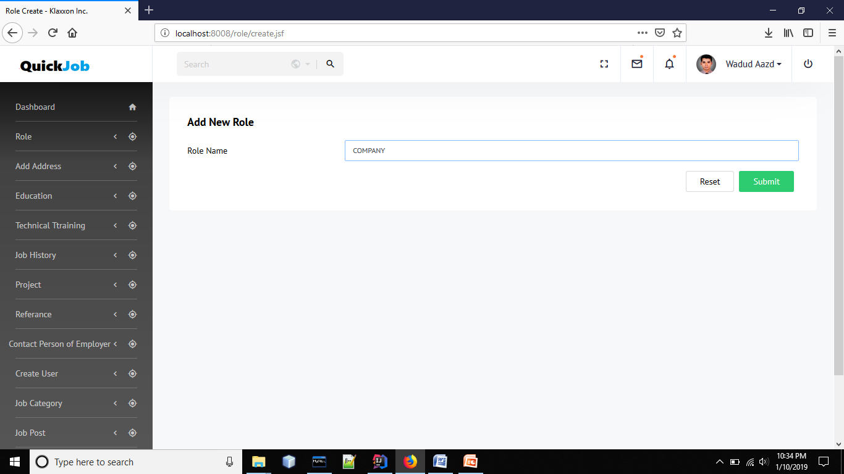

Slide 11
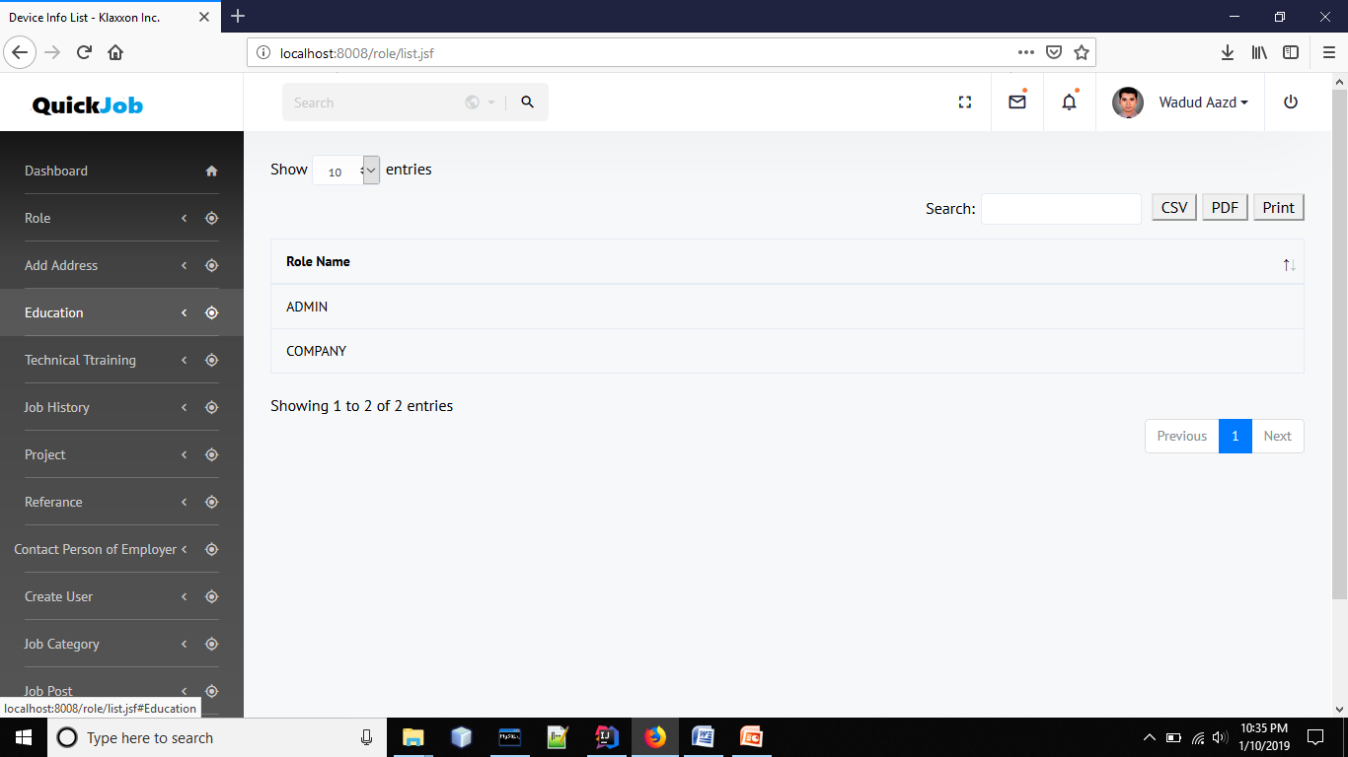

Slide 12
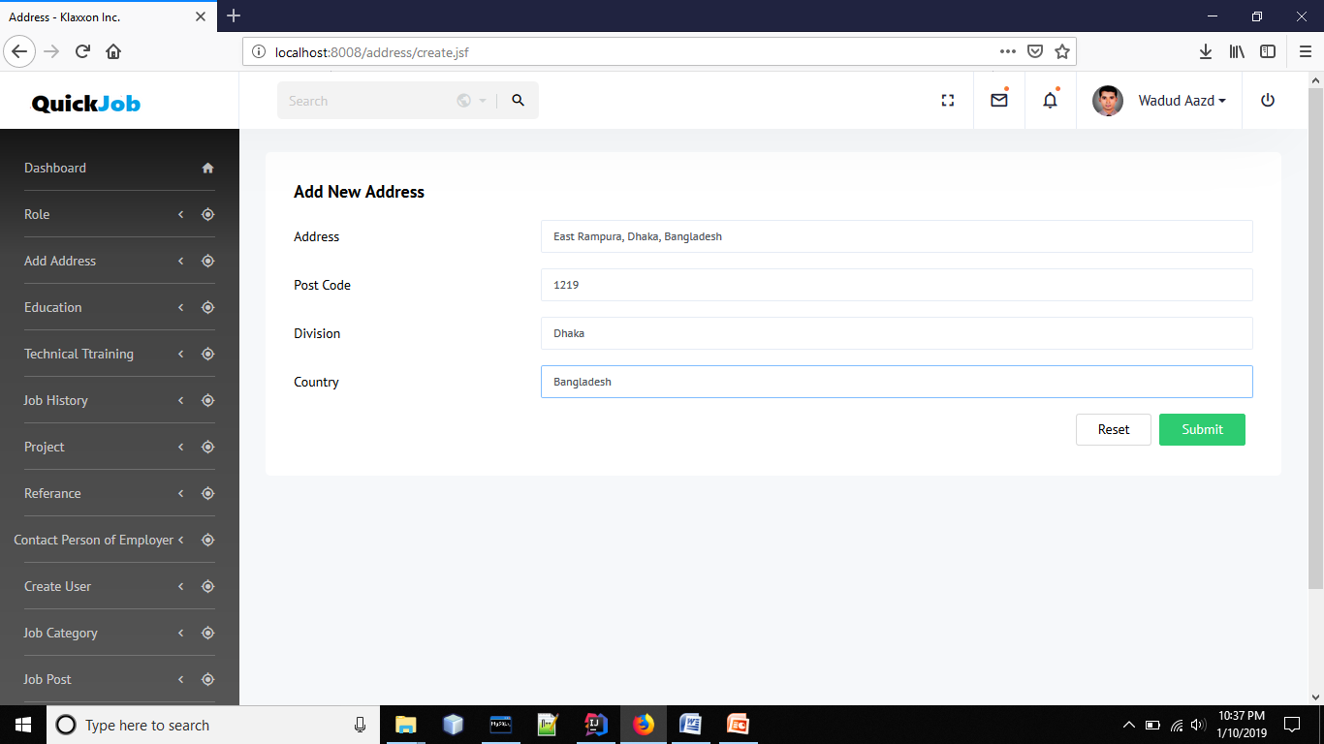

Slide 13
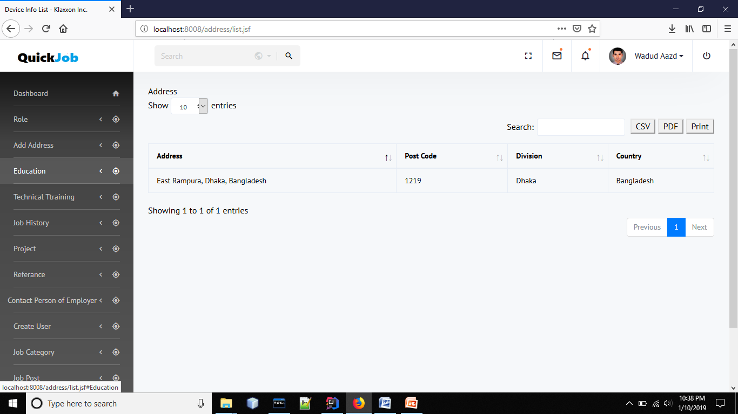

Slide 14
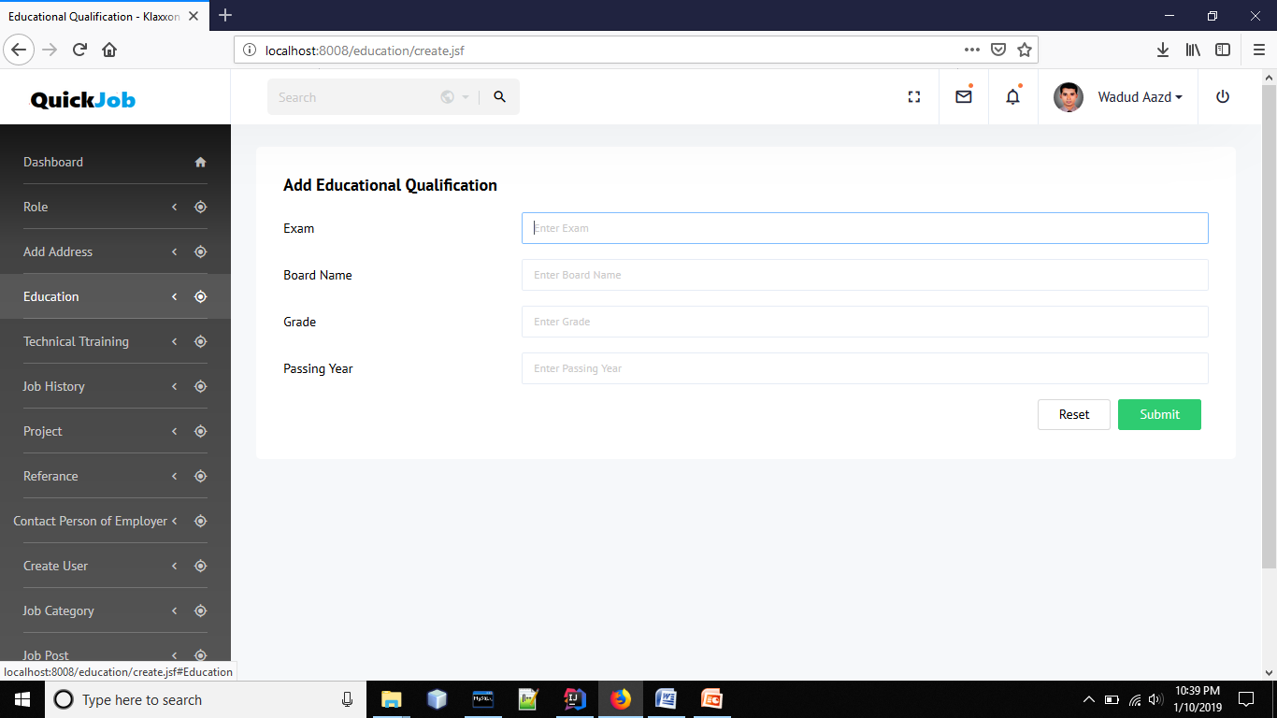

Slide 15
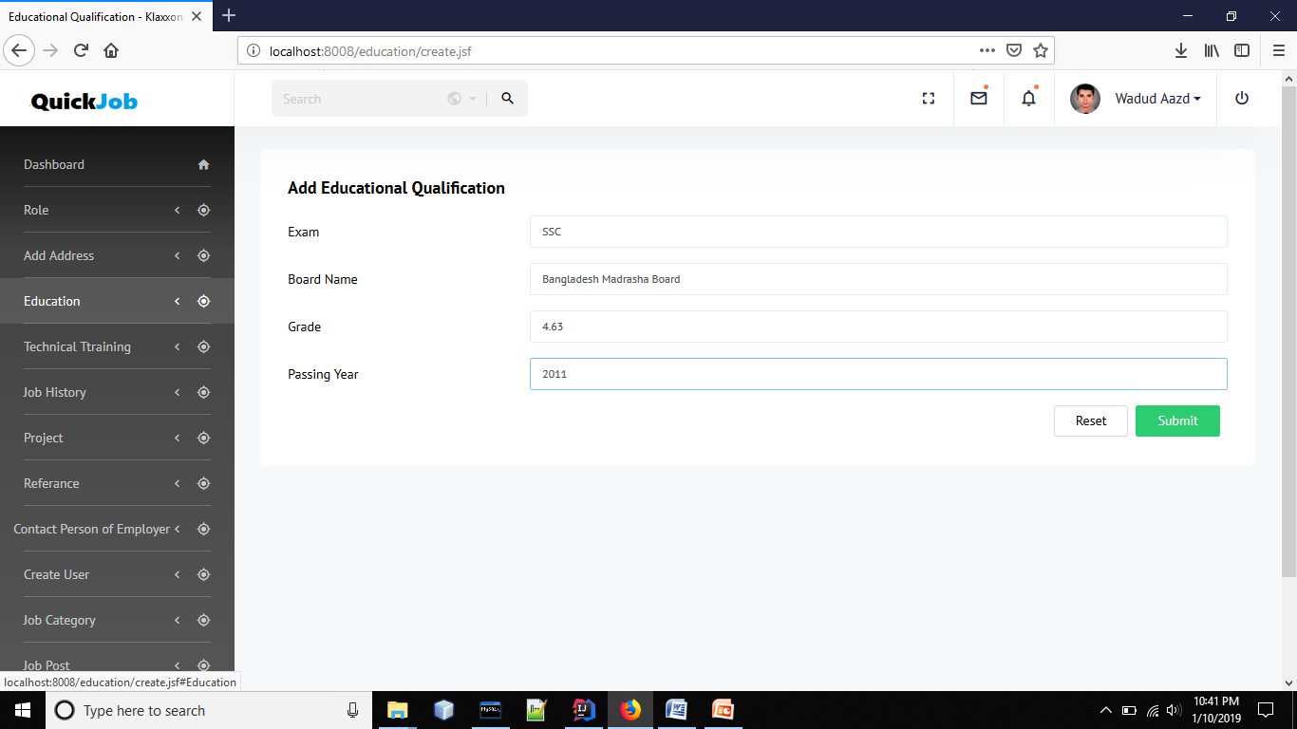

Slide 16
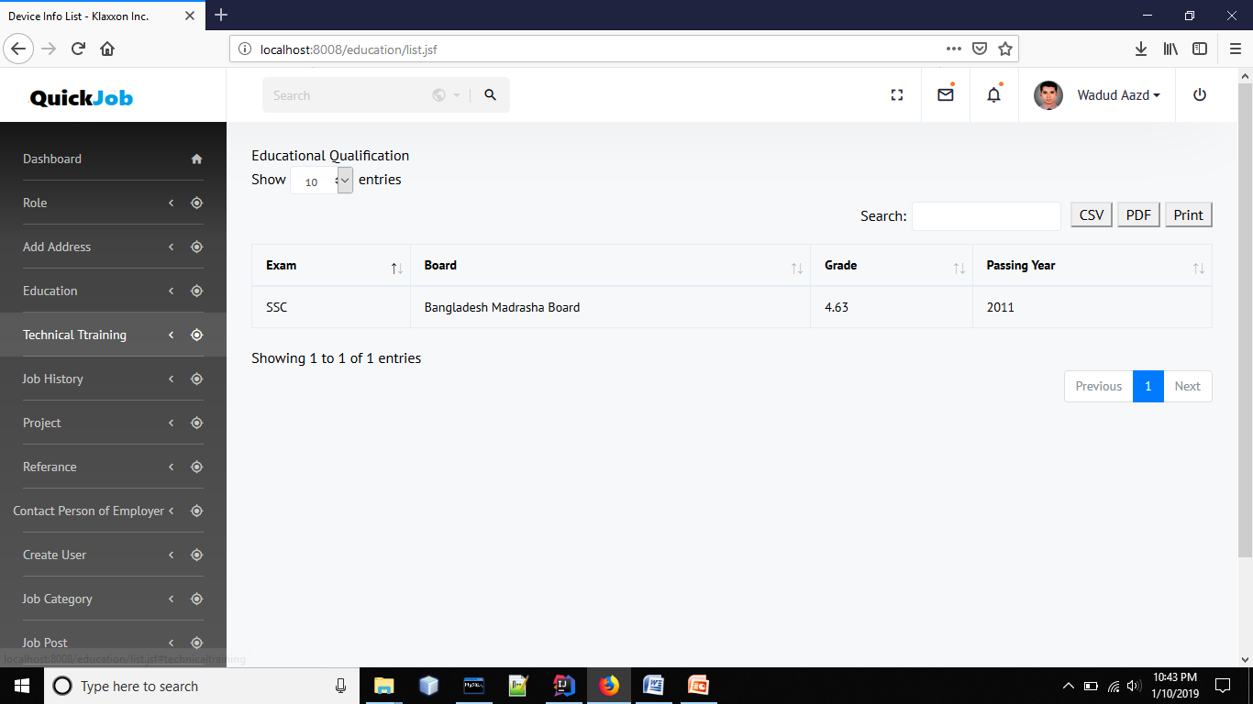

Slide 17
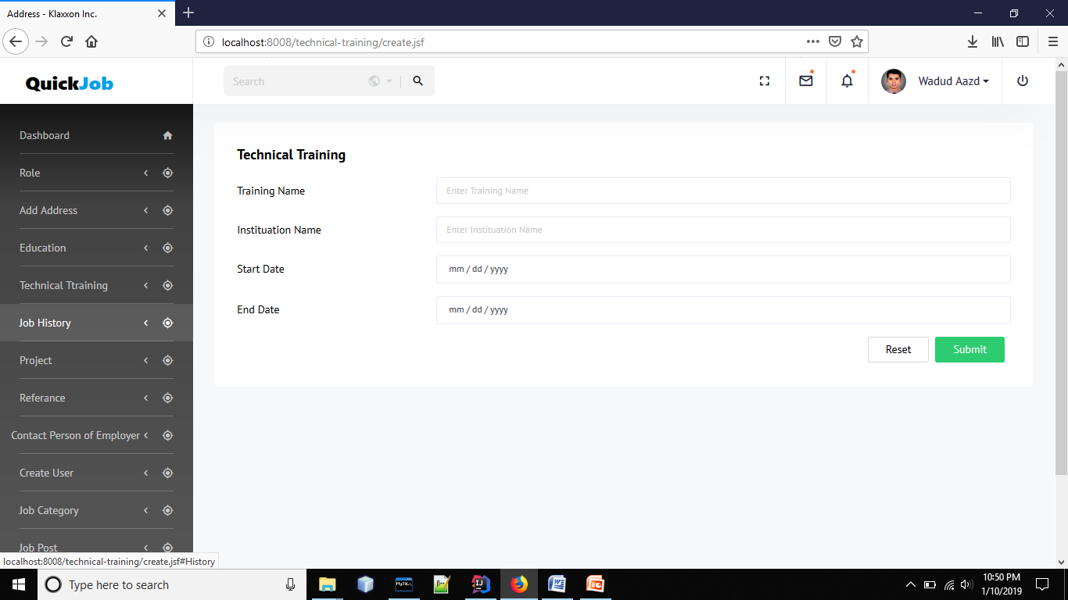

Slide 18


Slide 19
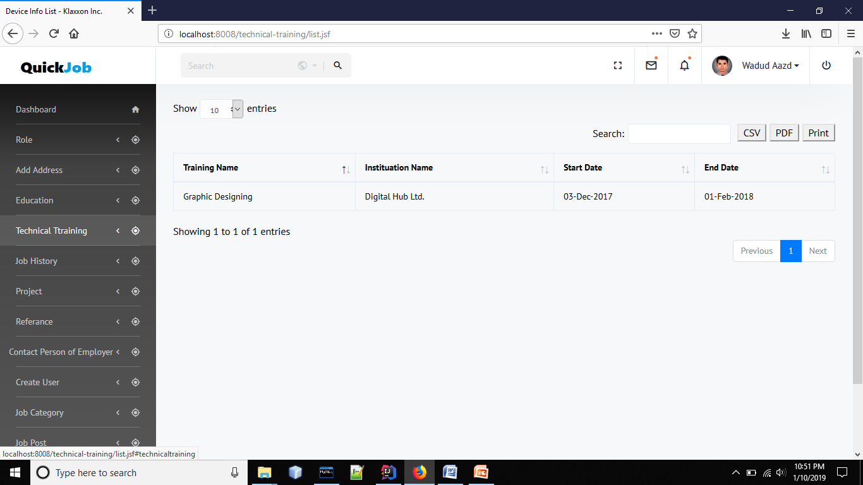

Slide 20


Slide 21
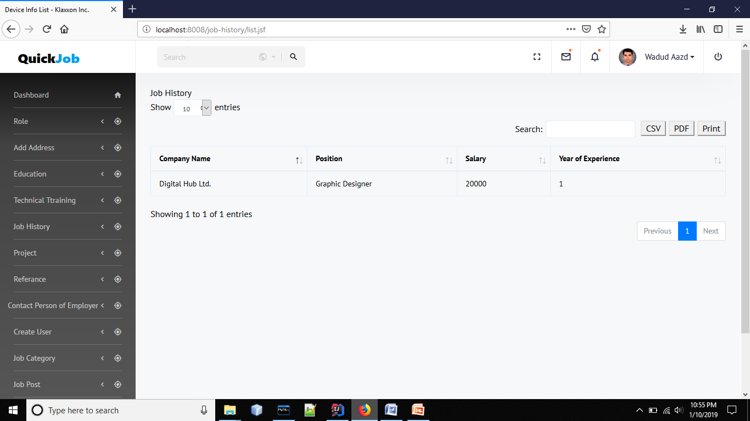

Slide 22
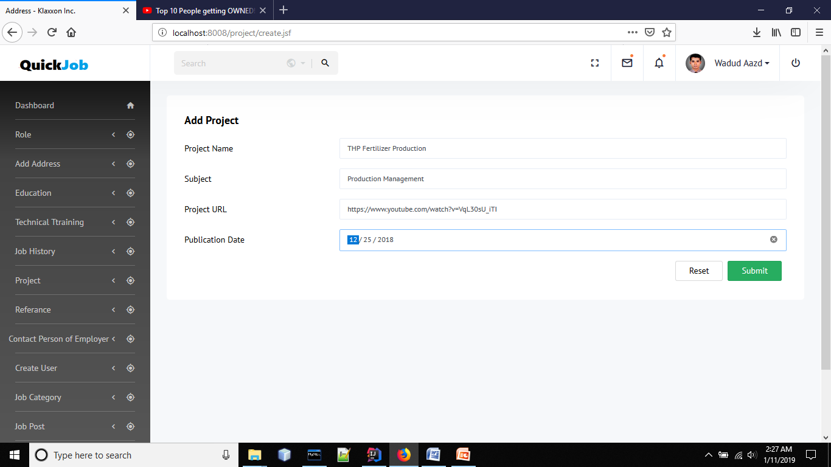

Slide 23
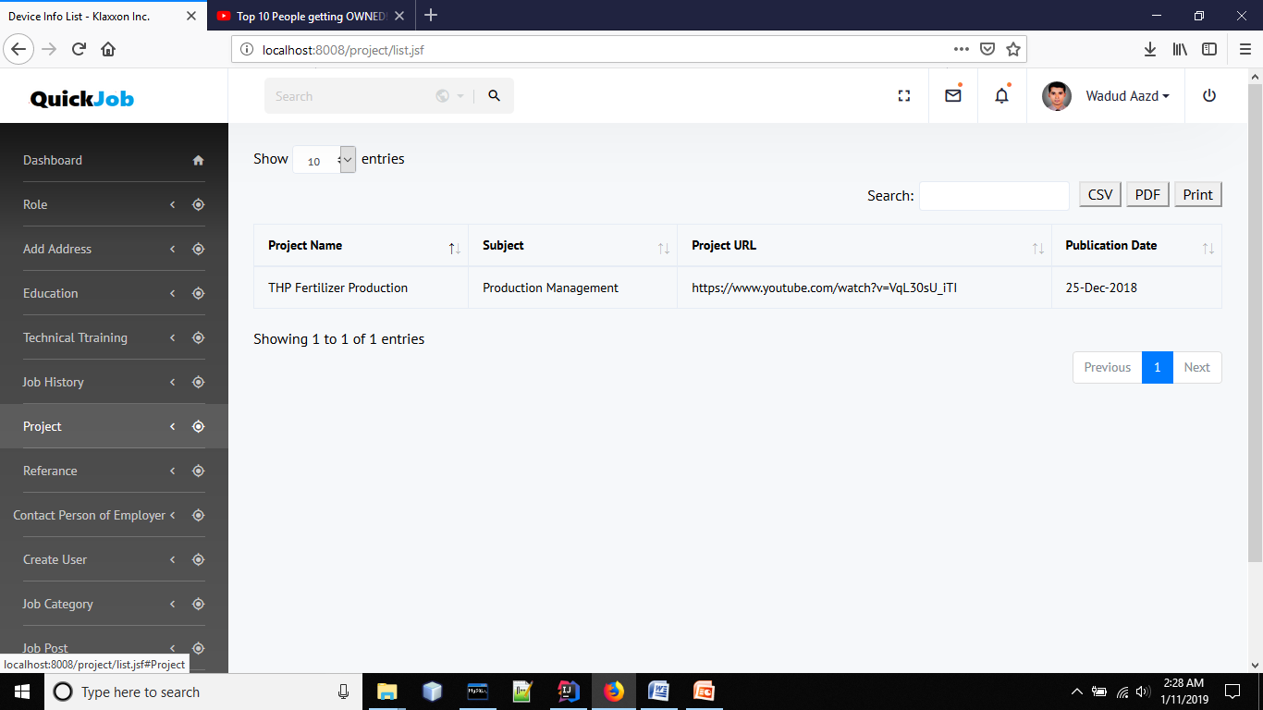

Slide 24
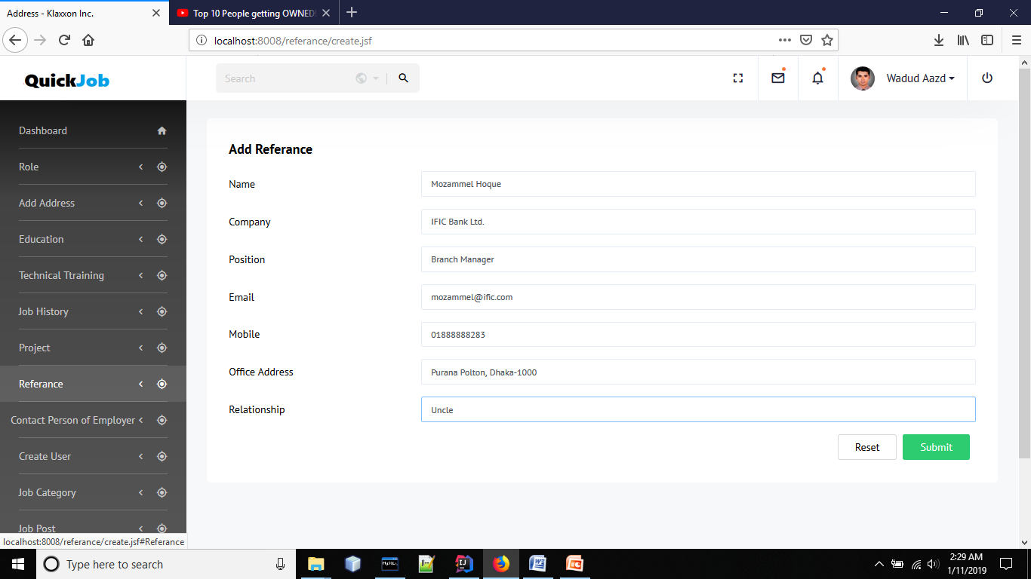

Slide 25
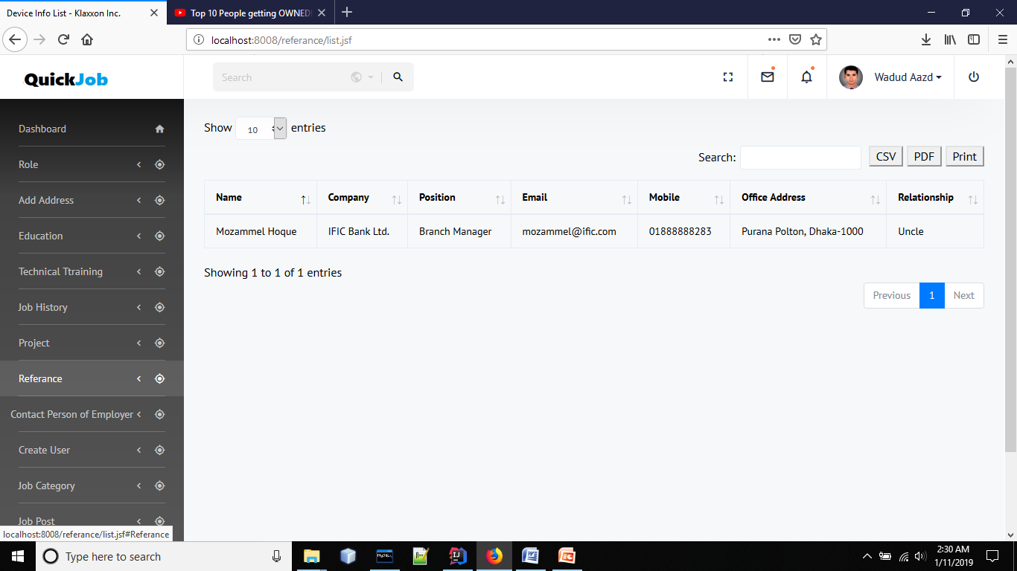

Slide 26


Slide 27
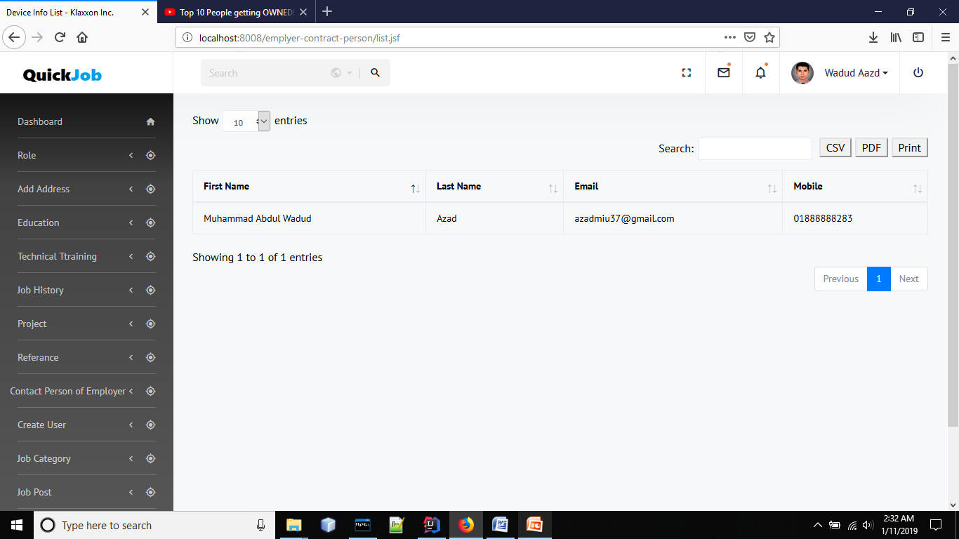

Slide 28
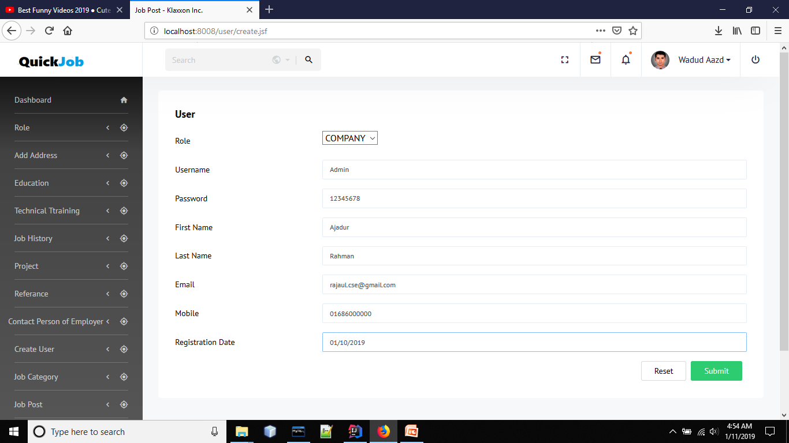

Slide 29
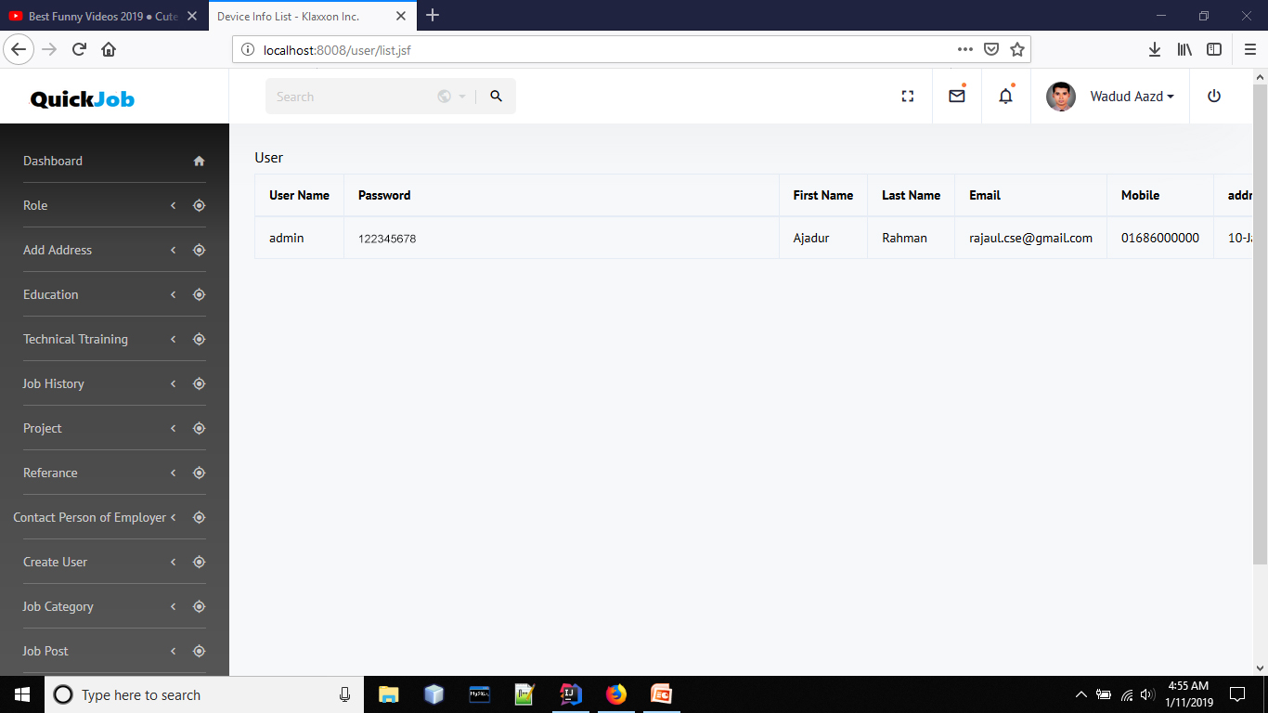

Slide 30
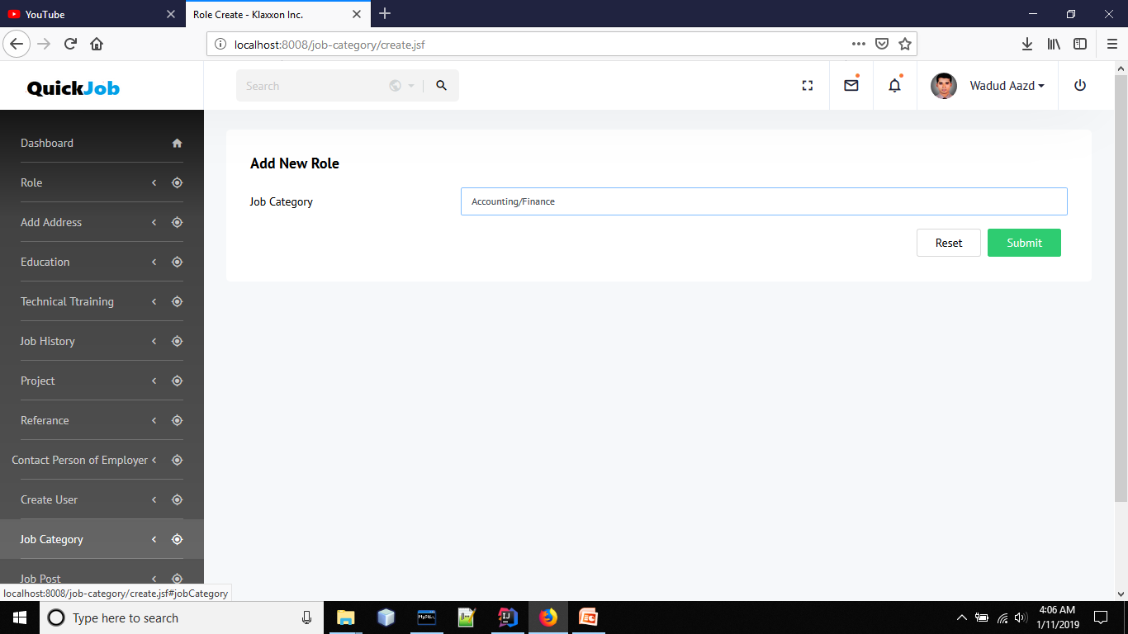

Slide 31
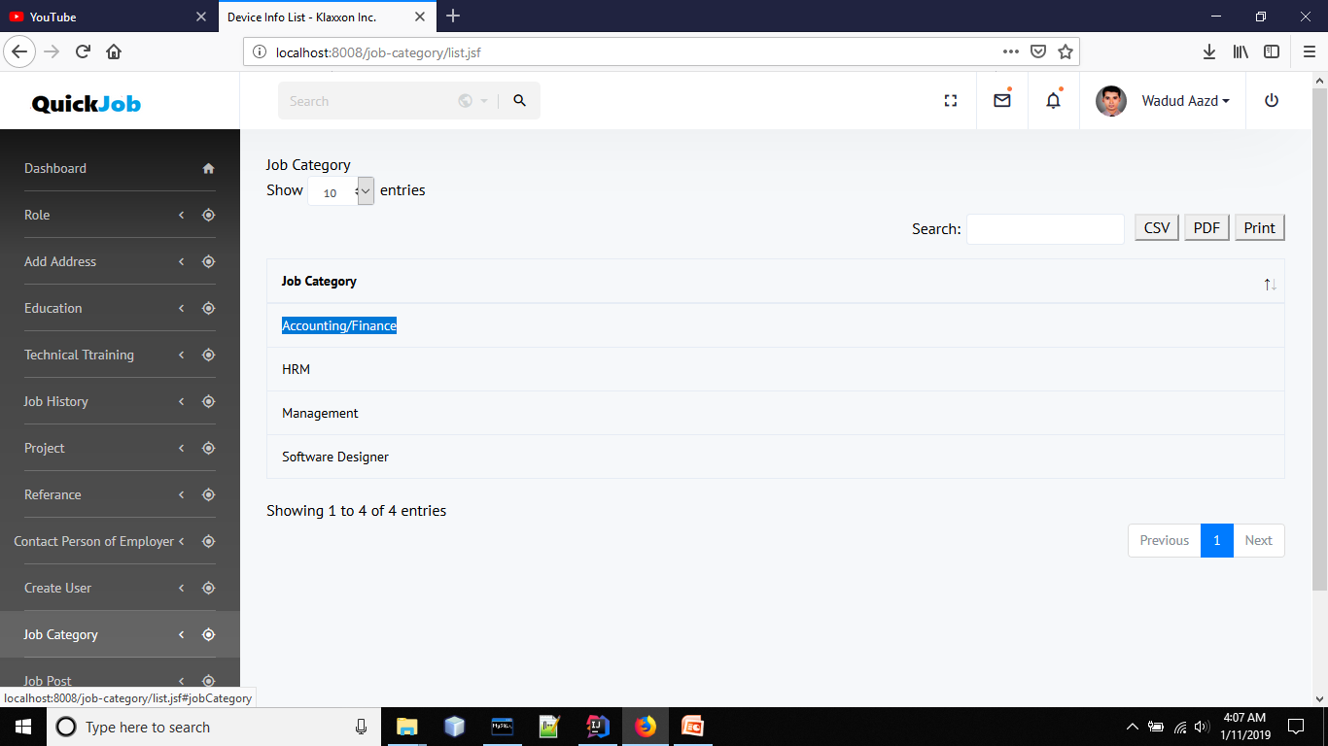

Slide 32
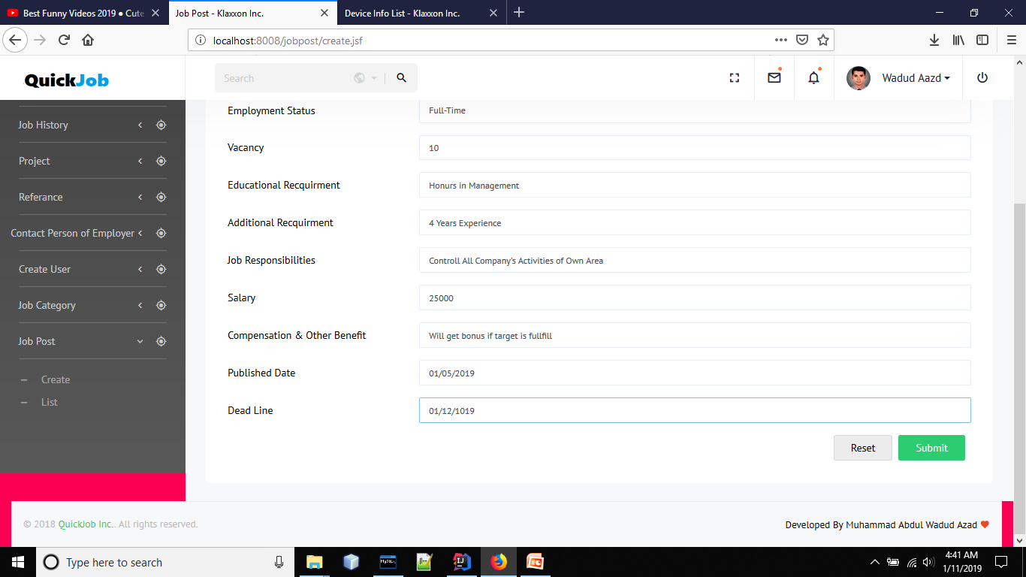

Slide 33
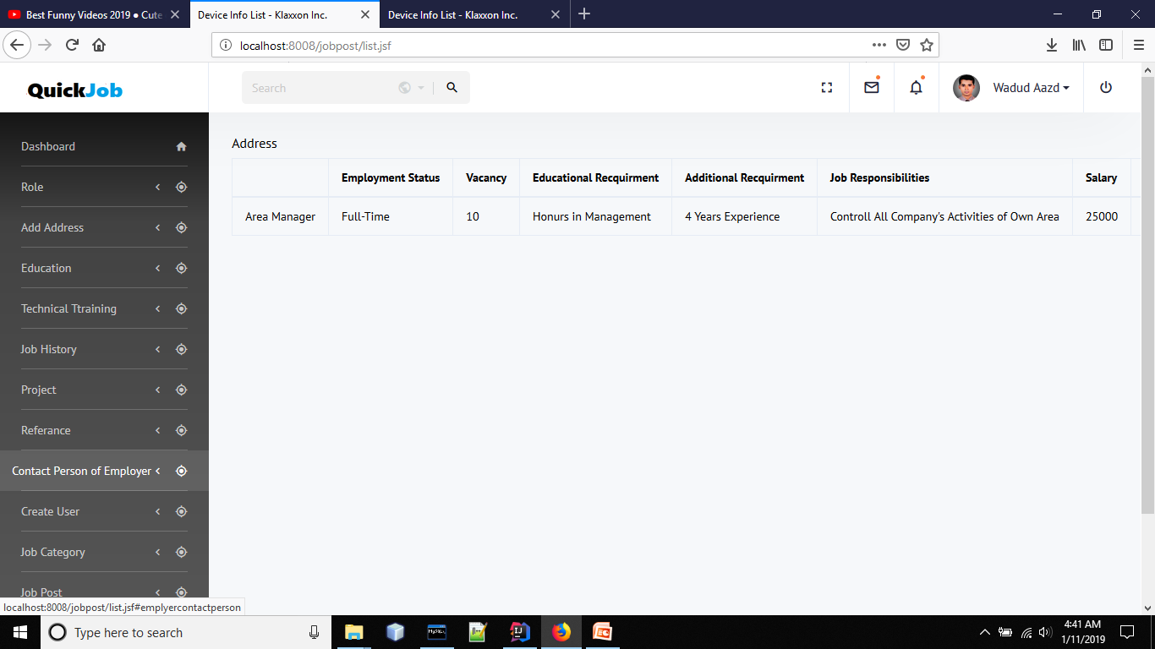

Slide 34


